Slide 1
2022 3Q~4Q
KUGODS Algorithm Study
week 3. 시간복잡도와 정렬 알고리즘

Slide 2
Code Review

Slide 3
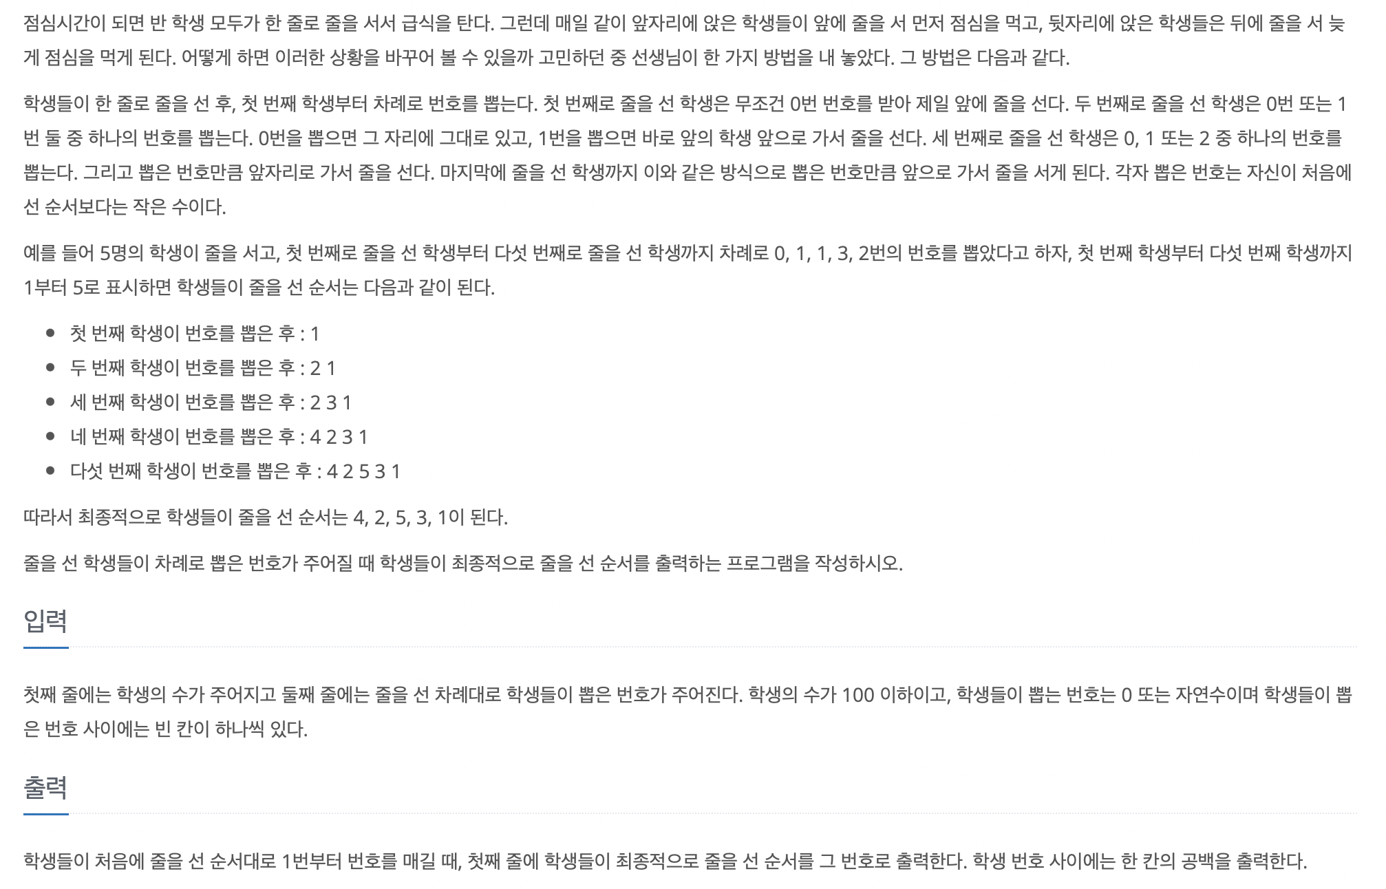
Code Review 2605:줄세우기

Slide 4
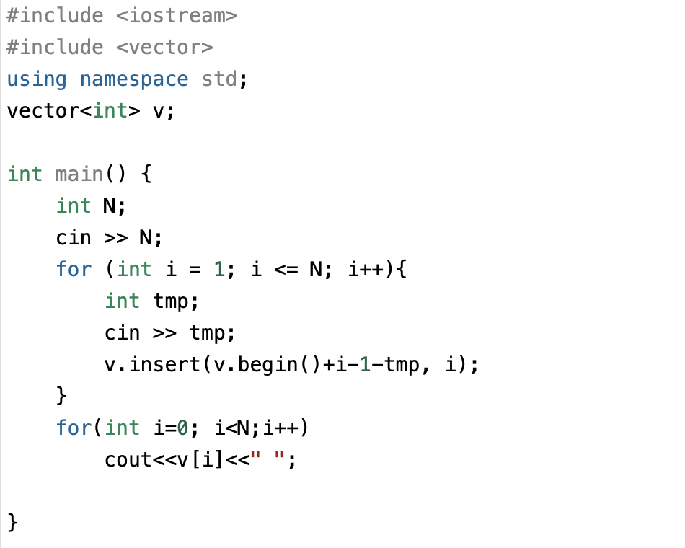
Code Review 2605:줄세우기

Slide 5
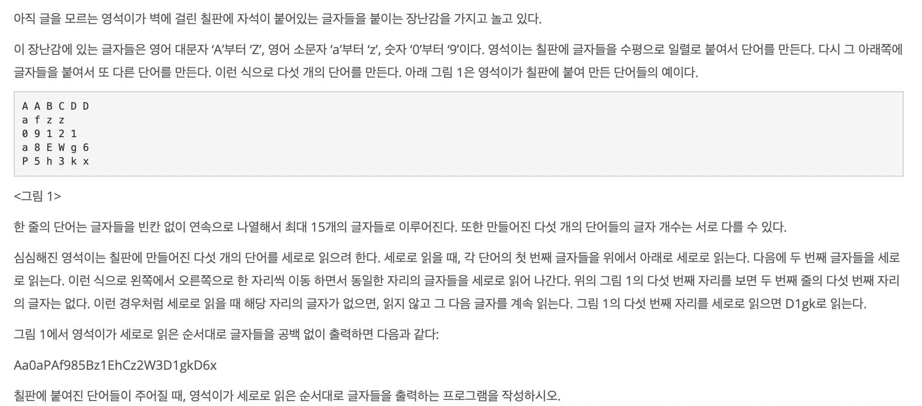
Code Review 10798:세로읽기

Slide 6
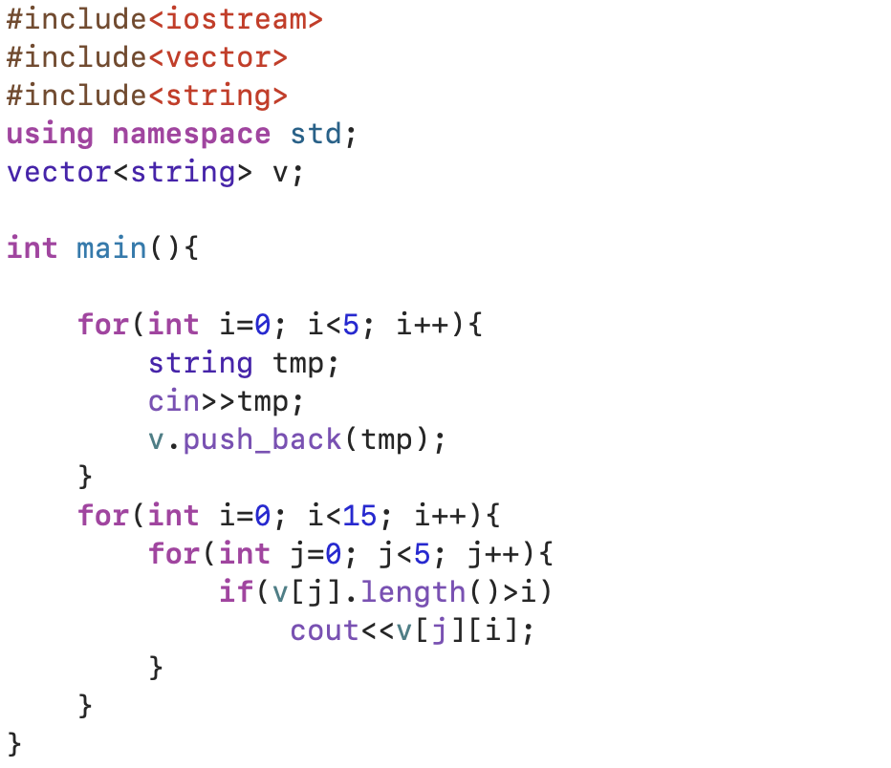
Code Review 10798:세로읽기

Slide 7
Time Complexity

Slide 8
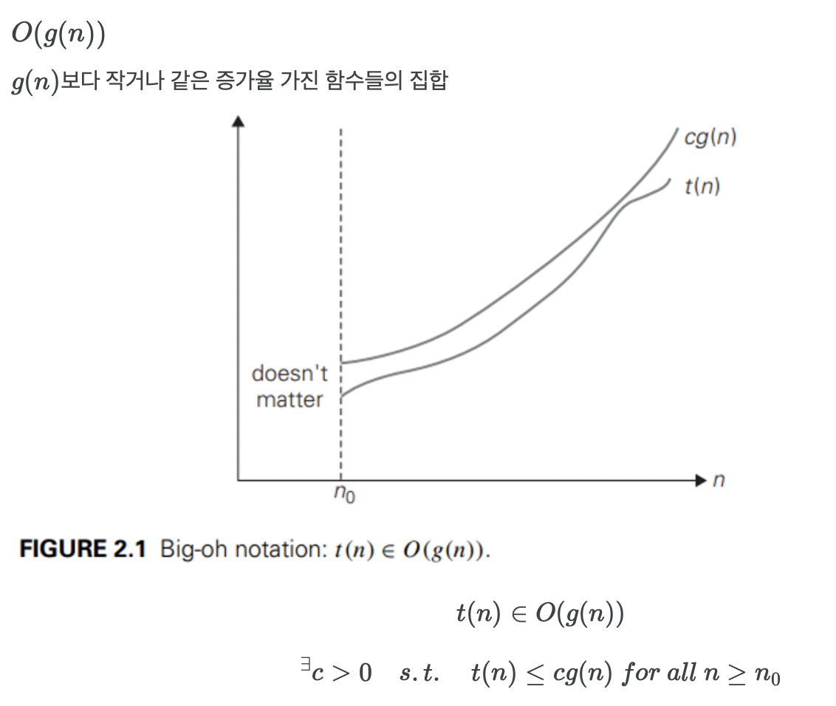
Time Complexity Big-oh notation

Slide 9
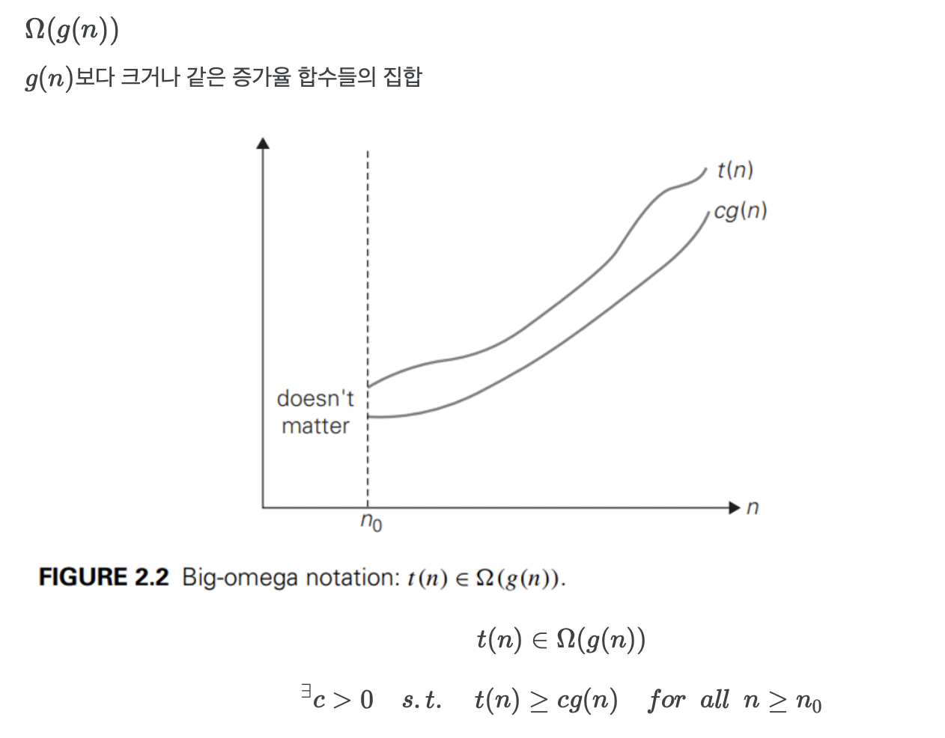
Time Complexity Big-omega notation

Slide 10
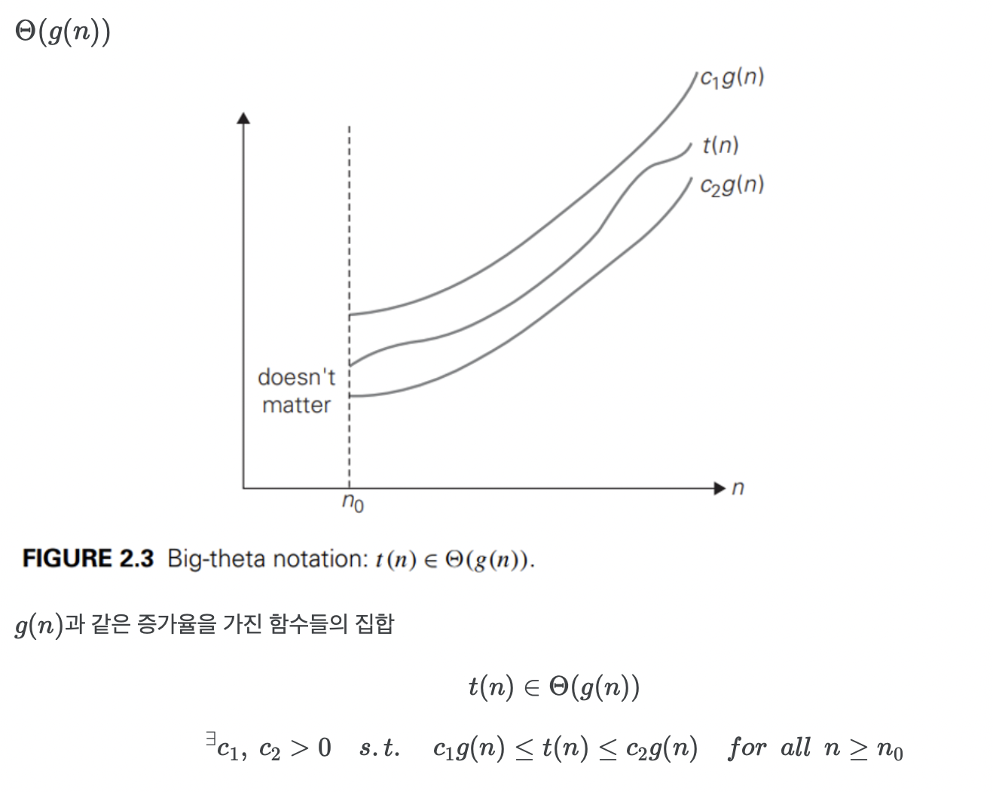
Time Complexity Big-theta notation

Slide 11

Time Complexity 왜 big-oh notation?
Ex) Sequential search (순차탐색)
Best-case :
$$1$$
$$\frac{1+⋯+n}{n}=\frac{n+1}{2}$$
$$n$$
Average-case :
Worst-case :

Slide 12
Sorting

Slide 13
Sorting O(n^2)

Slide 14
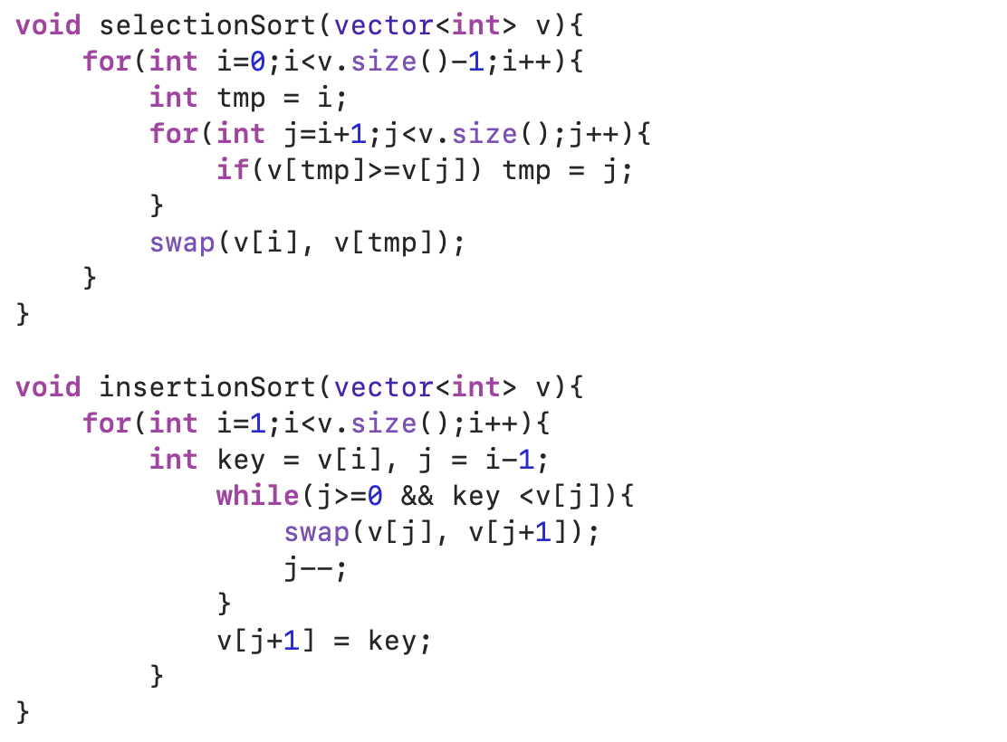
정렬 알고리즘 O(n^2)
Selection sort

Slide 15
정렬 알고리즘 O(n^2)
Insertion sort

Slide 16
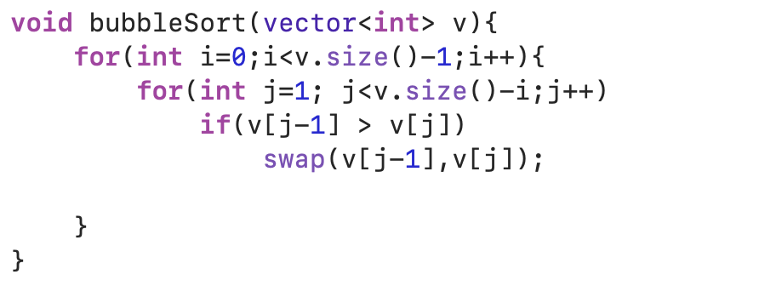
정렬 알고리즘 O(n^2)
Bubble sort

Slide 17
Sorting O(nlogn)

Slide 18
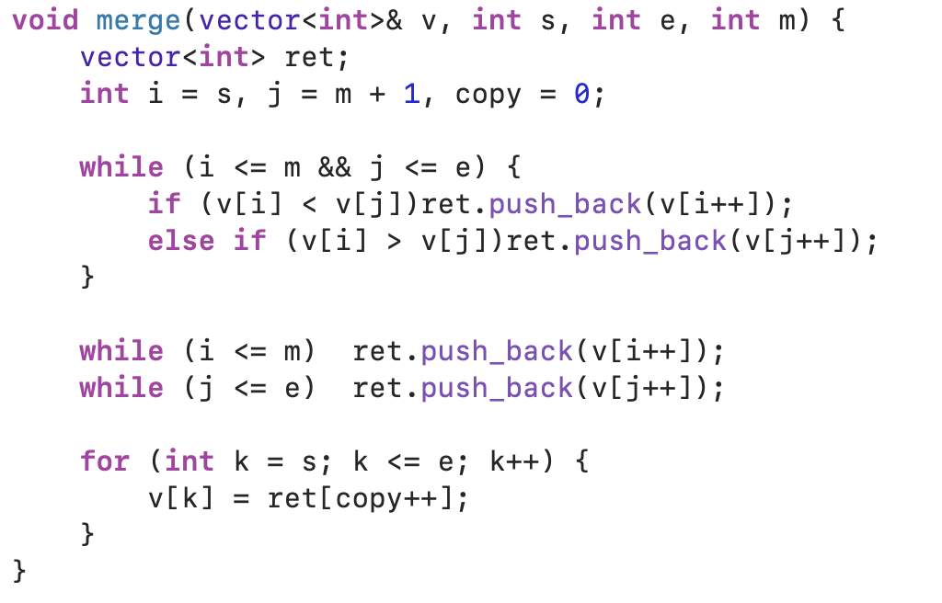
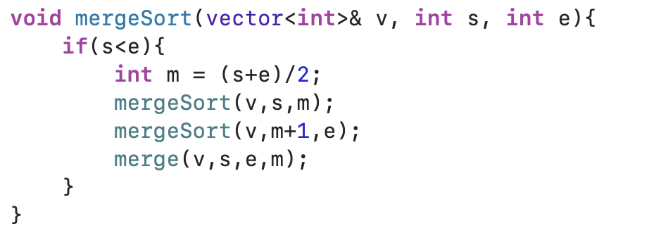
정렬 알고리즘 O(nlogn)
Merge sort

Slide 19
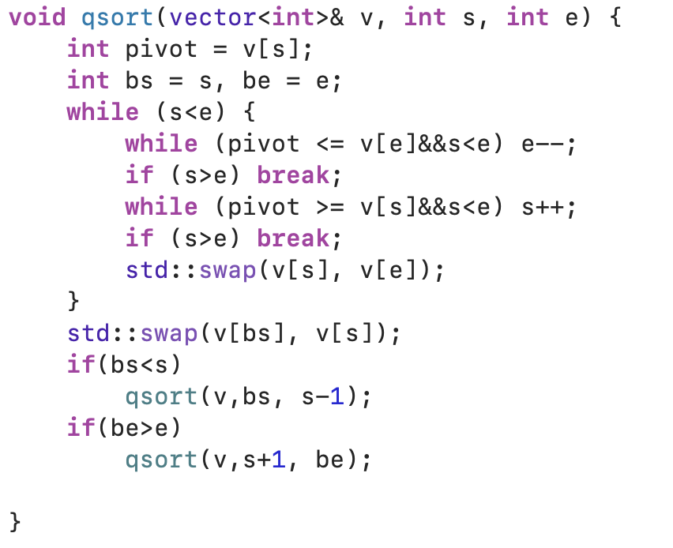
정렬 알고리즘 O(nlogn)
Quick sort

Slide 20
std::sort()

Slide 21
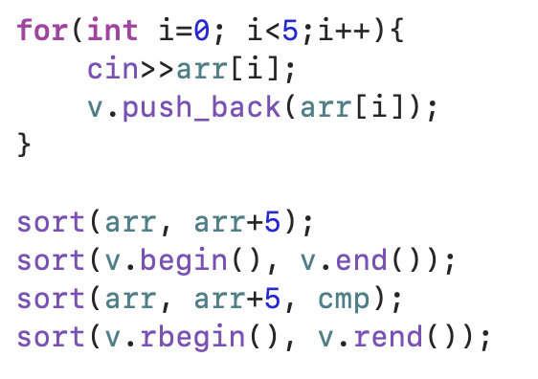
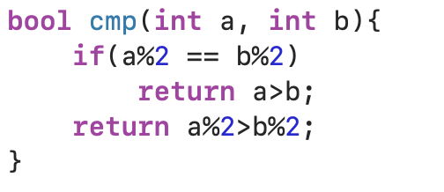
정렬 sort()
사용법
사용자 정의 함수

